Slide 1
Code output
KABAZZI RONALD 2023-B072-32782

Slide 2
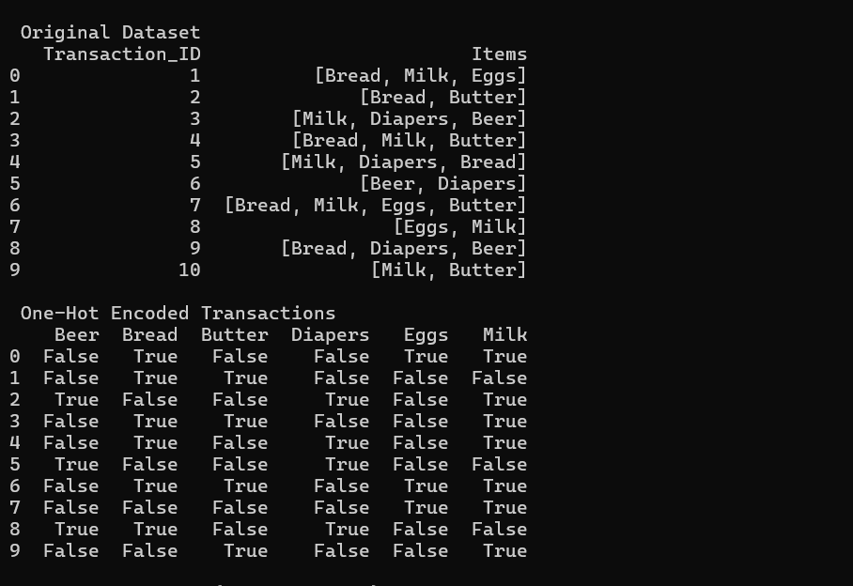
PART A DATASET AND TRANSACTION

Slide 3
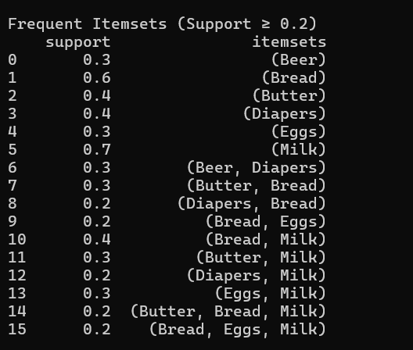
PART B APRIORI ALOGORITHM= FREQUENT ITEMSETS

Slide 4
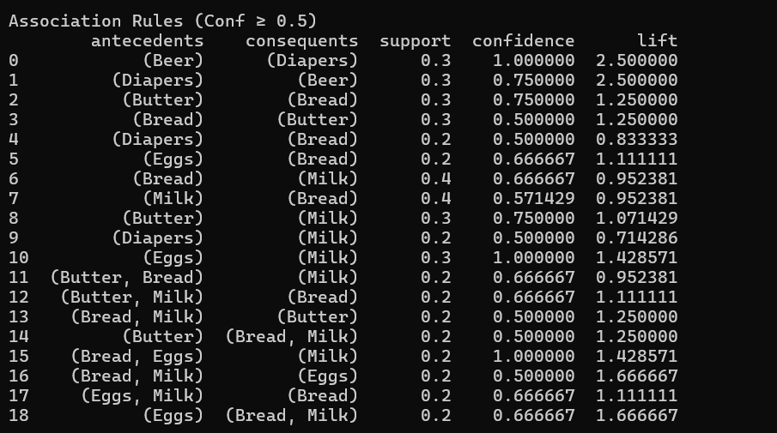
ASSOCIATION RULES

Slide 5
PART C: INTERPRETATION: Strongest Association Rules Based on Lift
Rule 1: {Diapers} → {Beer}
Interpretation:
This rule suggests that customers who purchase diapers have a high likelihood of also purchasing beer in the same transaction.
Implication:
The high lift value indicates a strong positive relationship, meaning these two items are frequently bought together more than would be expected by chance.
Rule 2: {Bread, Milk} → {Butter}
Interpretation:
Customers who buy bread and milk together are very likely to also buy butter.
Implication:
This reflects common household purchasing behavior where complementary grocery items are bought together for daily consumption.
Rule 3: {Eggs} → {Milk}
Interpretation:
This rule shows that customers purchasing eggs tend to also purchase milk.
Implication:
The association indicates that eggs and milk are staple items often bought together, especially for breakfast or home cooking.

Slide 6
Business Recommendations
1. Improve Product Placement
The supermarket should place diapers and beer closer to each other or promote them jointly.
This can increase cross-selling opportunities and raise the average transaction value.
2. Bundle and Promotion Strategies
The supermarket can offer bundle promotions for bread, milk, and butter.
Such promotions encourage customers to buy related items together, increasing sales and enhancing customer satisfaction.

